Slide 1

NETA PowerPoint® Slides
to Accompany
Prepared by
Katharine Ferguson,
Seneca College

Slide 2
Organizing and Drafting Business Messages
Chapter 5

Slide 3
Organizing and Drafting Business Messages
Research methods
Generate ideas
Organize data
Write effective sentences
Write effective paragraphs
Enhance readability

Slide 4
Phase 2 of 3-x-3 Writing Process
Researching
Organizing
Drafting

Slide 5
Gathering Information
Before drafting answer these questions:
What does the receiver need to know about this topic?
Does the receiver need to respond or take action? If so, how and when?
What will happen if the receiver doesn’t respond as anticipated?

Slide 6
What Are Informal Research Methods?
Informal research methods:
Search your company files.
Talk with your boss.
Interview the target audience.
Conduct an informal survey.
Notes:
Informal surveys gather unscientific but helpful information via questionnaires, telephone surveys, or online surveys.

Slide 7
Formal Research Methods
Access electronic sources. | The Internet Databases
Search manually. | Books, articles Other secondary sources
Investigate primary sources. | Interviews Surveys
Experiment scientifically. | Tests with experimental and control groups

Slide 8
Generating Ideas and Organizing Information
Brainstorming
Spontaneous contribution of ideas from members of a group
Emphasis is on quantity not quality of ideas
Ideas are evaluated and the best selected
Brainwriting
This involves writing out ideas rather than speaking them.

Slide 9
Comparing Brainstorming and Brainwriting
Brainstorming
Brainwriting
Clarify the problem and explain its background.
Establish a time limit for the session.
Set a goal, such as 100 ideas.
Require everyone to contribute or improve the ideas of others.
Define the problem and explain the background.
Before or at the meeting, emphasize writing out ideas.
In a group circle, present ideas. Or participants may write their ideas anonymously on paper hung on walls.

Slide 10
Comparing Brainstorming and Brainwriting
Brainstorming
Brainwriting
Emphasize quantity, not quality. No criticism.
Write ideas on flipcharts or on sheets of paper on the walls.
Organize, classify, and rank the ideas.
Choose the best ideas.
Classify the ideas into groups, deleting repetition.
Discuss the merits of each idea.
Vote to select the best ideas.

Slide 11
Crowdsourcing, Crowdstorming, and Crowdfunding
Crowdsourcing
Involves requesting ideas or services online from unknown crowd members rather than from traditional employees
Crowdstorming
Requires the crowd to evaluate and filter the ideas into a viable product or plan
Crowdfunding
Solicits contributions, usually through the Internet, from a group of friends or strangers to finance a project, cause, or business venture

Slide 12
Group Ideas to Show Relationships
Organize by grouping and strategizing.
Group similar items together and then place in a strategic sequence.
Use lists and outlines.
Organize by using the typical document components (e.g., a memo, an e-mail, and a letter have an opening, a body and a closing).

Slide 13
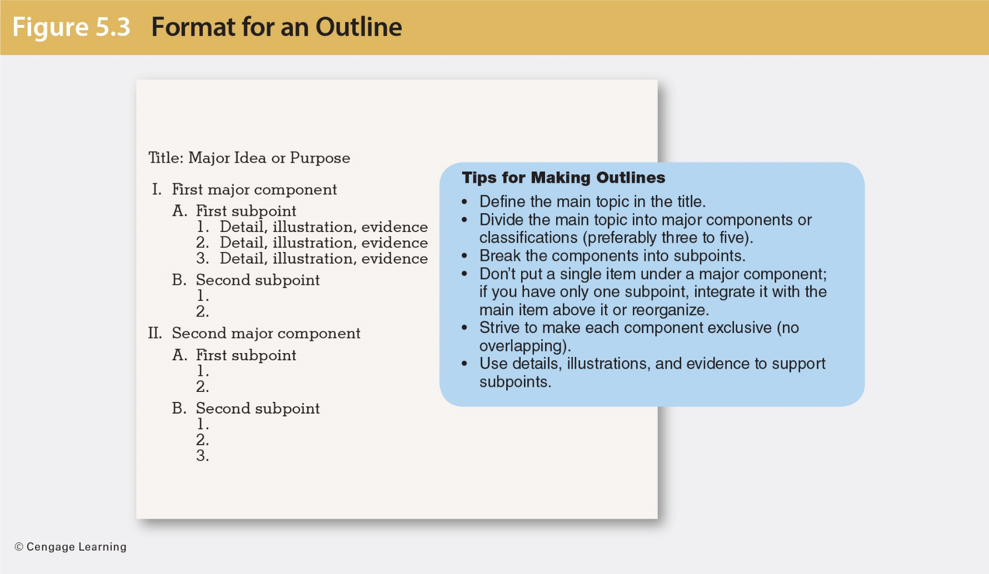
Format and Tips for Making an Outline

Slide 14
Organizing Ideas Into Strategies
Audience response determines the strategy:
Use a direct strategy for receptive audiences.
Use an indirect strategy for unreceptive audiences.

Slide 15
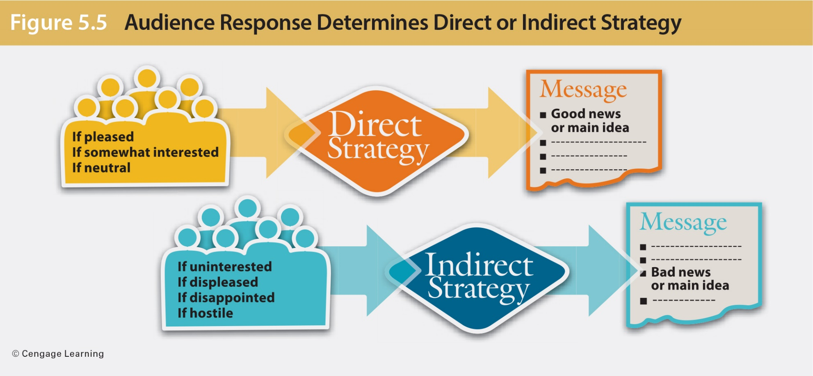
Organizing Ideas Into Strategies
Notes:
Use the direct pattern when you expect the reader to be pleased, mildly interested, or, at worst, neutral. Put your main point—the purpose of your message—in the first or second sentence.
The direct pattern saves the reader’s time, creates a proper frame of mind, and reduces frustration by frontloading the main idea.
When you expect the audience to be uninterested, unwilling, displeased, or perhaps even hostile, the indirect pattern is more appropriate. In this pattern, you don’t reveal the main idea until after you have offered explanation or evidence. This approach works well for bad news, persuasion, and sensitive news. The indirect pattern has three benefits:
Respects the feelings of the audience
Facilitates a fair hearing
Minimizes a negative reaction

Slide 16
Direct and Indirect Openings
Indirect Opening
Direct Opening
Our company has been concerned with attracting better-qualified job candidates. For this reason the Management Council has been gathering information about an internship program for college students. After considerable investigation, we have voted to begin a pilot program next fall.
The Management Council has voted to begin a college internship pilot program next fall.
Notes:
Before discussing the benefits of the direct method or frontloading, ask students to identify the benefits based on these examples.

Slide 17
Benefits of Frontloading
Direct method or frontloading:
Saves the reader’s time
Sets the proper frame of mind
Reduces frustration

Slide 18
Indirect Strategy for Unresponsive Audiences
The indirect strategy works well for the following:
Bad news
Ideas that require persuasion
Sensitive news, especially when it is being transmitted to superiors
Notes:
Ask students to think of situations that would suit the indirect pattern of organizing a message. Have they ever had to use this strategy to deliver bad news, or has this strategy ever been used on them by someone else? What was the outcome?

Slide 19
Benefits of Indirect Strategy
Respects the feelings of the audience
Facilitates a fair hearing
Minimizes a negative reaction

Slide 20
Composing the First Draft With Effective Sentences
Use four sentence types:
A simple sentence has one complete thought.
A compound sentence has two complete but related thoughts.
A complex sentence has an independent clause and a dependent clause.
A compound-complex sentence has at least two independent clauses and one dependent clause.

Slide 21
Avoid Three Common Sentence Faults
Fragments
Are usually broken-off parts of complex sentences
Can be identified by the words that introduce them—although, as, because, except, which
Run-on (fused) sentences
Are two independent clauses not joined by appropriate punctuation
Comma-splice sentences
Results when two independent clauses are joined by comma

Slide 22
Sentence Fragments
Fragment
Revision
Because most transactions require a permanent record. Good writing skills are critical.
The recruiter requested a writing sample. Even though the candidate seemed to communicate well.
Because most transactions require a permanent record, good writing skills are critical.
The recruiter requested a writing sample even though the candidate seemed to communicate well.

Slide 23
Run-on Sentences
Run-on Sentence
Revision
Many job seekers prepare traditional résumés some also use websites as electronic portfolios.
One candidate sent an e-mail another sent a link to her Web portfolio.
Many job seekers prepare traditional résumés. Some also use websites as electronic portfolios.
One candidate sent an e-mail résumé; another sent a link to her Web portfolio.

Slide 24
Comma-Splice Sentences
Comma Splice
Possible Revision
Some employees prefer their desktop computers, others prefer their tablets.
Tablets are useful during meetings, they are convenient for note-taking.
Some employees prefer their desktop computers; however, others prefer their tablets.
Tablets are useful during meetings. They are convenient for note-taking.

Slide 25
Use Short Sentences
Those under 20 words are most readable.
Sentence Length | Comprehension Rate
8 words | 100 percent
15 words | 90 percent
19 words | 80 percent
28 words | 50 percent
Notes:
Effective sentences are short and stress important ideas. Sentences of 20 or fewer words are easiest to understand.

Slide 26
Emphasizing Important Ideas
Choose vivid words and label the main idea.
General | Vivid
The way we socialize is changing. | Facebook has dramatically changed the way people socialize on the Web.
Unlabelled | Labelled
Explore the possibility of a Facebook fan page, but also consider security. | Explore the possibility of a Facebook fan page, but, most important, consider security.
Notes:
Emphasize an important idea by using vivid words, labelling the main idea, and placing the idea first or last in a sentence or making it the sentence subject.

Slide 27
Emphasize Important Ideas
Place important ideas first or last in the sentence.
Main Idea Lost | Main Idea Emphasized
Profit-sharing plans are more effective in increasing productivity when they are linked to individual performance rather than group performance. | Productivity is more likely to be increased when profit-sharing plans are linked to individual performance rather than to group performance.

Slide 28
Emphasize Important Ideas
Give important ideas the spotlight.
Main Idea Lost | Main Idea Clear
Although you are the first trainee we have hired for this program, we have interviewed many candidates and expect to expand the program in the future. | You are the first trainee we have hired for this program.

Slide 29
Emphasize Important Ideas
De-emphasize when necessary (i.e., bad news).
Emphasizes Harsh Statement | De-emphasizes Harsh Statement
Our records indicate you were recently fired. | Our records indicate that your employment status has recently changed.

Slide 30
Using Active and Passive Voice Effectively
Use active-voice verbs for most sentences.
Reveals the performer immediately
Use passive-voice verbs to
Emphasize an action rather than a person
De-emphasize negative news
Conceal the doer of an action
Notes:
In active-voice sentences the subject is the doer; in passive-voice sentences the subject is acted on.

Slide 31
Using the Active and Passive Voice Effectively
Active Voice
Passive Voice
Actor → Action Justin must submit a tax return.
Actor → Action Officials reviewed all tax returns.
Actor → Action We cannot make cash refunds.
Actor → Action Our CPA made a big error in the budget.
Received ← Action The tax return was submitted (by Justin).
Received ← Action All tax returns were reviewed (by officials).
Received ← Action Cash refund cannot be made.
Received ← Action A big error was made in the budget.

Slide 32
Using Parallelism
Parallelism is a balancing technique:
Use similar structures to express similar ideas.
Match nouns with nouns, verbs with verbs, and clauses with clauses.
Avoid mixing active-voice verbs with passive-voice verbs.

Slide 33
Using Parallelism
Lacks Parallelism | Illustrates Parallelism
The policy affected all vendors, suppliers, and those involved with consulting. | The policy affected all vendors, suppliers, and consultants. (Matches nouns.)
Our primary goals are to increase productivity, reduce costs, and the importance of product quality. | Our primary goals are to increase productivity, reduce costs, and improve product quality. (Matches verbs.)

Slide 34
Using Parallelism
Lacks Parallelism
Illustrates Parallelism
Our ads have three objectives:
We want to increase product use.
Introduce complementary products.
Our corporate image will be enhanced.
Our ads have three objectives:
Increase product use.
Introduce complementary products.
Enhance our corporate image.
(Matches verbs in listed items.)

Slide 35
Escaping Dangling Modifiers
Avoid dangling modifiers.
Ensure the word or phrase it describes is not missing.
Not this: Skilled at graphic design, the contract went to Design One.
But this: Skilled at graphic design, Design One won the contract.
Notes:
Modifiers must be close to the words they describe or limit.
A dangling modifier describes or limits a word or words that are missing from the sentence. To fix a dangling modifier, supply the missing part of the sentence.
A misplaced modifier occurs when the word or phrase it describes is not close enough to be clear. To fix a misplaced modifier, move the modifier closer to the word(s) it describes or limits.

Slide 36
Escaping Misplaced Modifiers
Avoid errors with modifiers.
Keep phrases close to the words they describe.
Not this: The recruiter interviewed candidates who had excellent computer skills in the morning.
But this: In the morning the recruiter interviewed candidates who had excellent computer skills.

Slide 37
Drafting Effective Sentences
Use a variety of sentence types.
Avoid common sentence faults.
Control sentence length.
Emphasize important ideas.
Apply active- and passive-voice verbs strategically.
Employ parallelism.
Eliminate dangling and misplaced modifiers.
Notes:
This slide summarizes how to draft effective sentences.

Slide 38
Building Well-Organized Paragraphs
Paragraphs are groups of sentences about one idea.
They group similar ideas together.
They build coherence and use transitional expressions.
Notes:
Effective paragraphs focus on one topic, link ideas to build coherence, and use transitional devices to enhance coherence.

Slide 39
Building Well-Organized Paragraphs
Paragraphs may be composed of three kinds of sentences:
Topic sentence: expresses the primary idea of the paragraph
Supporting sentence: illustrates, explains, or strengthens the primary idea
Limiting sentence: opposes the primary idea by suggesting a negative or contrasting thought; may precede or follow the main sentence

Slide 40
Well-Organized Paragraphs
Create paragraphs that follow one of three classic paragraph plans:
Direct plan
Pivoting plan
Indirect
plan

Slide 41
Effective Paragraphs: Direct Plan
Direct plan—common in business
Indirect plan
Pivoting plan
Define, classify, illustrate, or describe
Main sentence
Supporting sentences
Main sentence
(Limiting sentence)
Supporting sentences
Notes:
This plan is useful whenever you must define (a new product or procedure), classify (parts of a whole), illustrate (an idea), or describe (a process). Start with the main sentence, then strengthen and amplify that idea with supporting ideas.

Slide 42
Direct Plan: Example With Optional Limiting Sentence
Main
sentence
Limiting
sentence
Supporting
sentences
Flexible work scheduling could immediately increase productivity and enhance employee satisfaction in our entire organization.
Such scheduling, however, is impossible for all employees.
Managers would be required to maintain their regular hours. For many other employees, though, flexible scheduling permits extra time to manage family responsibilities. Feeling less stress, employees are able to focus their attention better at work; hence they become more relaxed and more productive.
Notes:
You can alter the direct plan by adding a limiting sentence if necessary. Be sure, though, that you follow with sentences that return to the main idea and support it.

Slide 43
Effective Paragraphs: Pivoting Plan
Direct plan
Pivoting plan
Indirect plan
Compare and contrast
Limiting sentences
Main sentence
Supporting sentences
Notes:
Paragraphs arranged in the pivoting plan start with a limiting sentence that offers a contrasting or negative idea before delivering the topic sentence. The pivoting plan is particularly useful for comparing and contrasting ideas. In using the pivoting plan, be sure to emphasize the turn in direction with an obvious but or however.

Slide 44
Pivoting Plan: Example
Limiting
sentence
Main sentence
Supporting sentences
Foreign service careers are certainly not for everyone. Many representatives are stationed in remote countries where harsh climates, health hazards, security risks, and other discomforts exist.
However, careers in the foreign service offer rewards for the special people who qualify.
Foreign service employees enjoy the pride and satisfaction of representing Canada abroad. They enjoy frequent travel, enriching cultural and social experiences in living abroad, and action-oriented work.

Slide 45
Effective Paragraphs: Indirect Plan
Direct plan
Pivoting plan
Indirect plan
Persuade, deliver bad news, or
describe cause and effect
Supporting sentences
Main sentence
Notes:
Paragraphs arranged in the indirect plan start with the supporting sentences and conclude with the topic sentence. This useful plan enables the writer to build a rationale—a foundation of reasons—before hitting the audience with the main idea, possibly one that is bad news. This indirect plan works well for describing causes and effects.

Slide 46
Indirect Plan: Example
Supporting
sentences
Main
sentence
According to a recent poll, more than half of all white-collar workers are now dressing casually at work. Many high-tech engineers and other professionals have given up suits and ties, favouring khakis and sweaters instead. Our own consultants say they stand out like “sore thumbs” because they are attired in traditional buttoned-down styles, while the businesspeople they visit are usually wearing casual clothing.
Therefore, I recommend that we establish an optional “business casual” policy, allowing consultants to dress casually as they perform their duties both in and out of the office.

Slide 47
Developing Paragraph Coherence
Sustain the key idea by repeating or rephrasing it.
Our philosophy holds that every customer is really a guest. All new employees to our theme parks are trained to treat guests as VIPs. We take pride in respecting our guests. As VIPs, the guests are never told what they can or cannot do.

Slide 48
Dovetailing Sentences
Dovetail sentences: connect the beginning of each new sentence with the end of the previous sentence.
New guides learn about the theme park and its facilities. These facilities include telephones, food services, bathrooms, and attractions, as well as the location of offices. Knowledge of administrative offices and the internal workings of the company is required of all staffers.
Notes:
Sentences are dovetailed when an idea at the end of one connects with an idea at the beginning of the next. Dovetailing of sentences is especially helpful with dense, difficult topics.

Slide 49
Including Pronouns
Use a pronoun as a link to an antecedent.
All new park employees receive a two-week orientation. They learn that every staffer has a vital role in preparing for the show. This training includes how to maintain enthusiasm.
Notes:
Familiar pronouns such as we, they, he, she, and it, help build continuity, as do demonstrative pronouns such as this, that, these, and those. These words confirm that something under discussion is still being talked about.

Slide 50
Transitional Expressions That Build Coherence
To Add or Strengthen | To Show Time or Order | To Clarify
additionally | after | for example
again | before | for instance
also | earlier | I mean
besides | finally | in other words
likewise | first | that is
moreover | meanwhile | this means
furthermore | next | thus

Slide 51
Transitional Expressions That Build Coherence
To Show Cause and Effect | To Contradict | To Contrast
accordingly | actually | as opposed to
as a result | but | at the same time
consequently | however | by contrast
for this reason | in fact | conversely
so | instead | on the contrary
therefore | rather | on the other hand
hence | though | similarly

Slide 52
Controlling Paragraph Length
Eight or fewer printed lines (not sentences) are most readable and look inviting.
Don’t put the reader to sleep! Improve comprehension.
Notes:
Compose short paragraphs for readability. Business writers recognize that short paragraphs are more attractive and readable than longer ones. Paragraphs with eight or fewer lines look inviting. Long, solid chunks of print appear formidable. If a topic can’t be covered in eight or fewer printed lines (not sentences), consider breaking the topic into smaller segments.

Slide 53
Preparing Meaningful Paragraphs
Develop one idea.
Use the direct plan.
Use the pivoting plan.
Use the indirect plan.
Build coherence with linking techniques.
Provide road signs with transitional sentences.
Limit paragraph length.
Notes:
This slide summarizes how to develop meaningful paragraphs.

Slide 54
Applying Document Design to Enhance Readability
Employ white space (empty space).
Understand margins and text alignment:
Lines can align only at the left (ragged right).
Lines can align only at the right.
Lines can align at both left and right (justified).
Lines can be centred.

Slide 55
Applying Document Design to Enhance Readability
Business letters and memos usually have side margins of 2.5 to 3 cm.
Ragged-right margins provide more white space and improve readability.
Readers are usually best served by using left-justified text and ragged-right margins without justification.
Centred text is appropriate for headings and short invitations but not complete messages.

Slide 56
Choosing Appropriate Typeface
Serif typefaces
Have small features at the ends of strokes (e.g., Times New Roman, Century, Georgia, and Palatino)
Suggest tradition, maturity, and formality
Are frequently used in body text in business messages and longer documents

Slide 57
Choosing Appropriate Typeface
Sans serif typefaces
Include Arial, Calibri, Gothic, Tahoma, Helvetica, and Univers
Have clean characters and are widely used for headings, signs, and material that does not require continuous reading
Generally, use no more than two typefaces within one document.

Slide 58
Using Type Font, Sizes, and Listing Techniques
Font:
Refers to specific style within a typeface
Is a mechanical means of adding emphasis (i.e., ALL CAPS, small caps, and bold are useful for headings)
Should not be in ALL CAPS AS THIS FEELS LIKE SHOUTING AND IRRITATES READERS
Is effective for calling attention to important points by using boldface, italics, and underlining
Should be 11- to 12-point type for body text and larger for headings

Slide 59
Numbering and Bulleting Lists
Lists provide high skim value.
Lists look professional:
Use numbered lists to present sequences.
Use bulleted lists to highlight items.
Capitalize the initial word in the list.
Punctuate the end of the listed items if they are complete sentences.
Use parallelism to make all lines consistent (e.g., start each with a verb).
Notes:
Skim value refers to browsing quickly to grasp main ideas.

Slide 60
Adding Headings for Visual Impact
Are an effective tool for highlighting information and improving readability
Encourage writers to group similar ideas
Enable skimming
Improve readability through main headings, subheadings, and category headings

Slide 61
Summary of Learning Objectives
Apply Phase 2 of the 3-x-3 writing process, which begins with research to collect background information.
Explain how to generate ideas resulting from brainstorming, brainwriting, and social media techniques.
Compose the first draft of the message by using a variety of sentence types and avoiding common sentence errors.

Slide 62
Summary of Learning Objectives
Improve your writing techniques by carefully constructing sentences.
Draft well-organized paragraphs and use techniques for achieving paragraph coherence.
Enhance readability by understanding document design.

